Slide 1
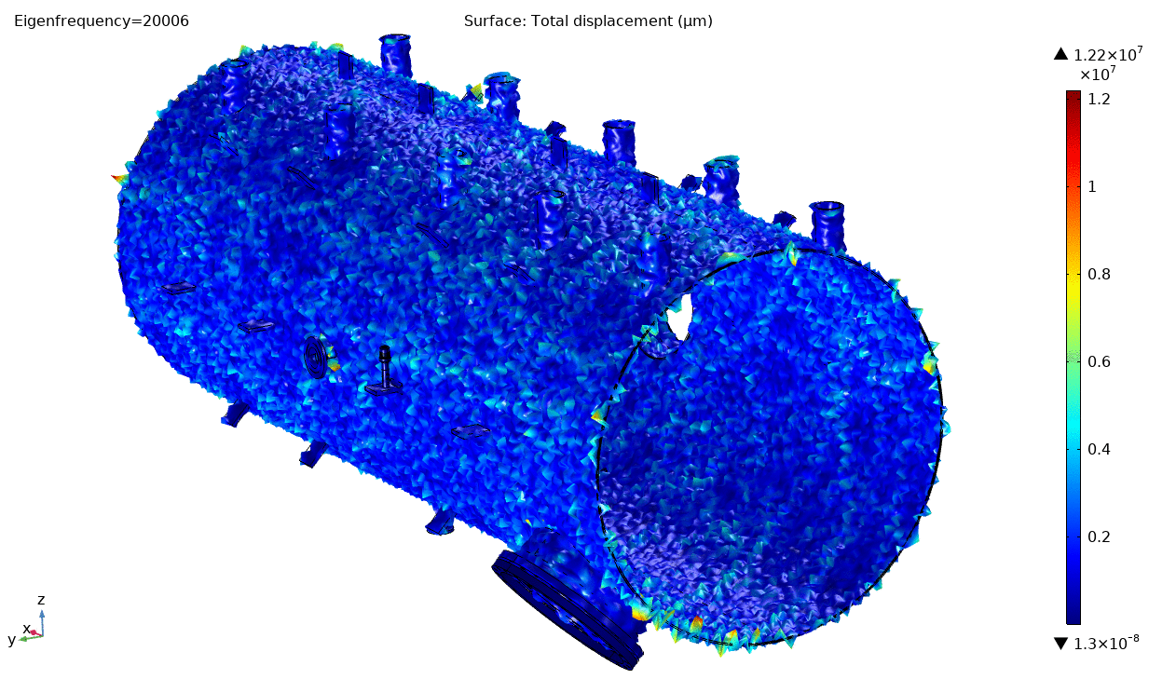

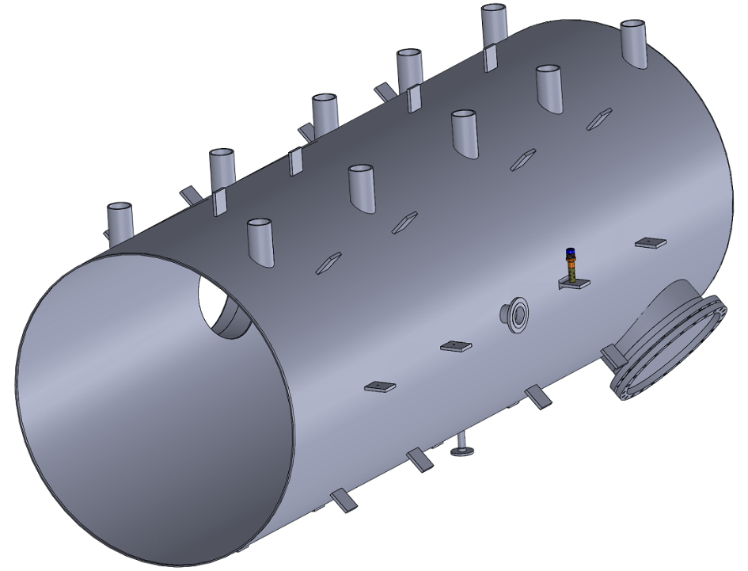
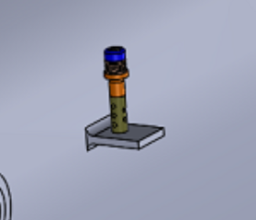
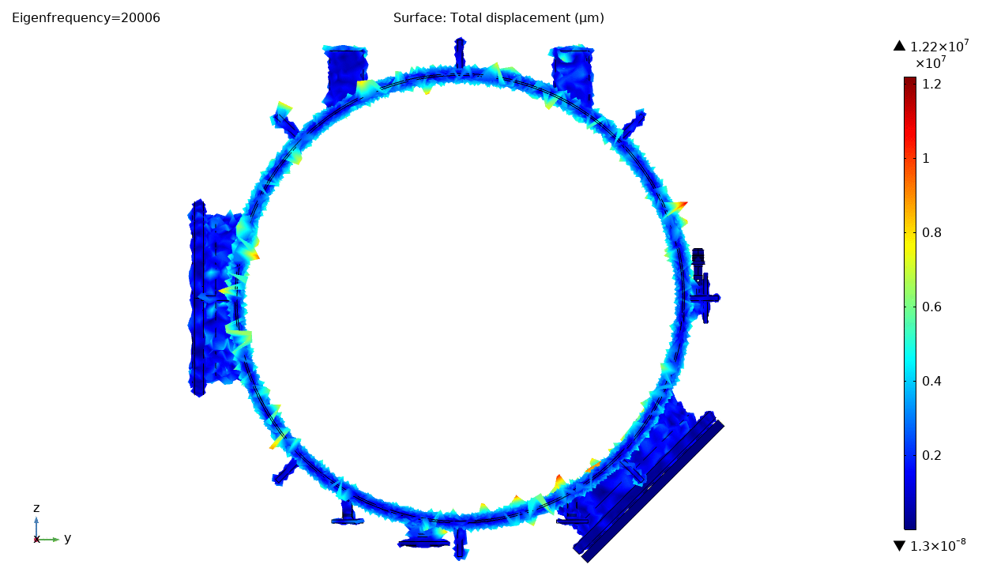
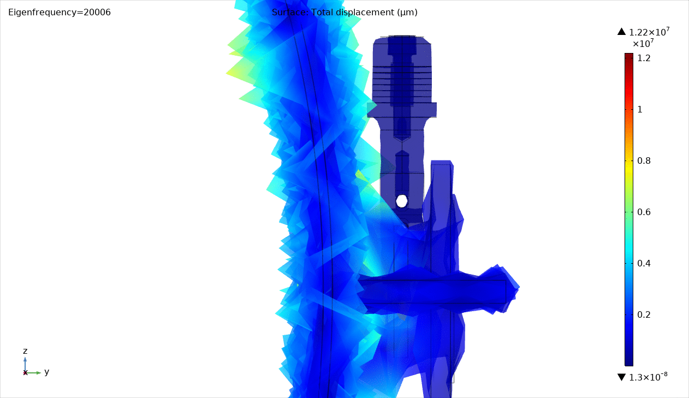
Descaling Heat Exchangers with 1 Transducer
OD = 2 m
Length = 5 m
Wall Thickness = 10 mm
2020 ® MP Interconsulting || Marais 36, 2400 Le Locle, Switzerland ||www.UltrasonicsWorldGroup.com || mpi@mpi-ultrasonics.com

Slide 2
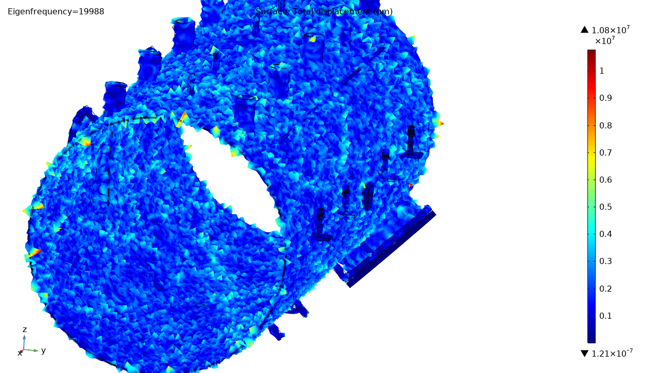
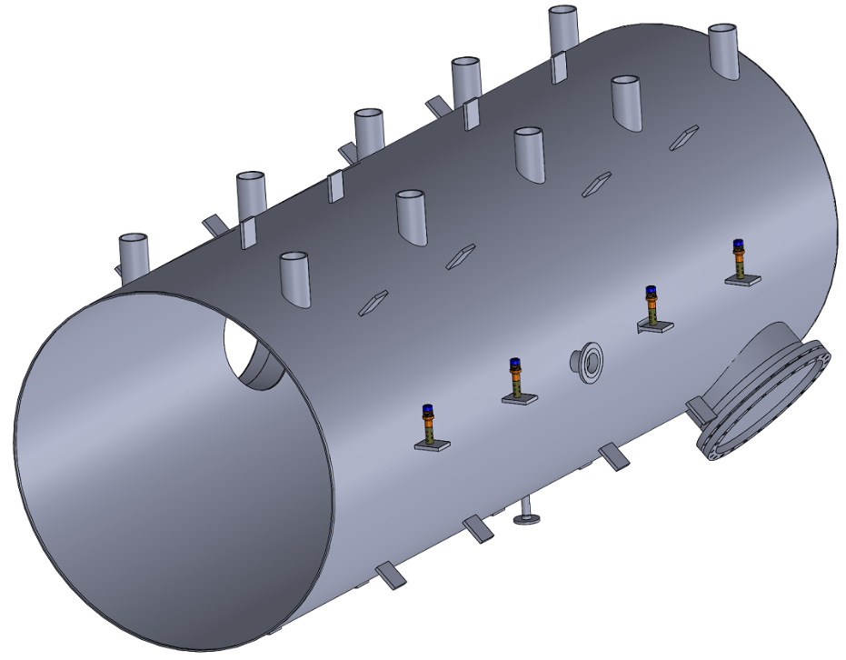
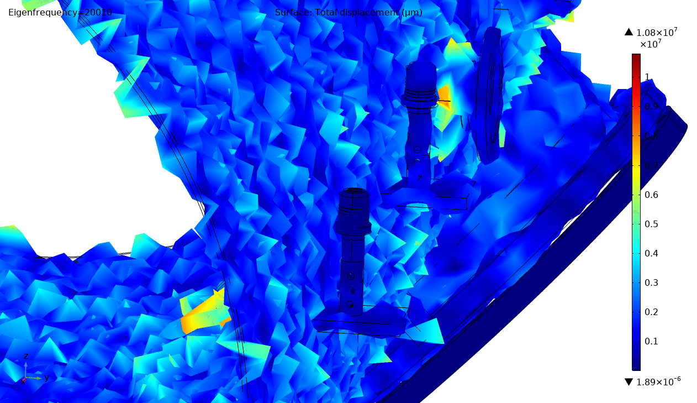
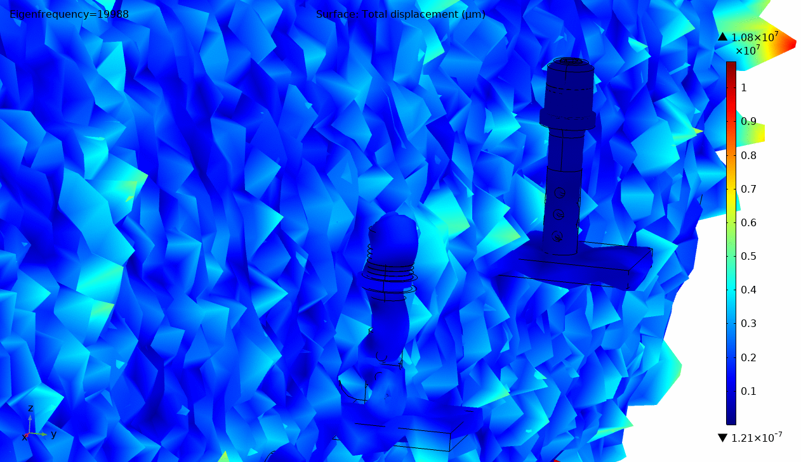
Size-dependent Descaling of Heat Exachangers with 4 Transducers
This solution intends to apply more than 1 transducer, of course each of them will have a proper resonant frequency.
OD = 2 m
Length = 5 m
Wall Thickness = 10 mm
19980 Hz
20100 Hz
2020 ® MP Interconsulting || Marais 36, 2400 Le Locle, Switzerland ||www.UltrasonicsWorldGroup.com || mpi@mpi-ultrasonics.com

